Slide 1
Overview and business goals
Tasty Bytes is a search engine for recipes. For a monthly subscription the company puts together a full meal plan to ensure the family are getting a healthy, balanced diet whatever the budget.
The team have noticed that if they display a popular recipe on the homepage, the traffic of the website goes up by up to 40% which leads to more subscriptions.
Therefore, the company would like a data scientist to:
- Predict which recipes will lead to high traffic.
- Correctly predict high traffic recipes 80% of the time.
- Make recommendations for next steps.

Slide 2
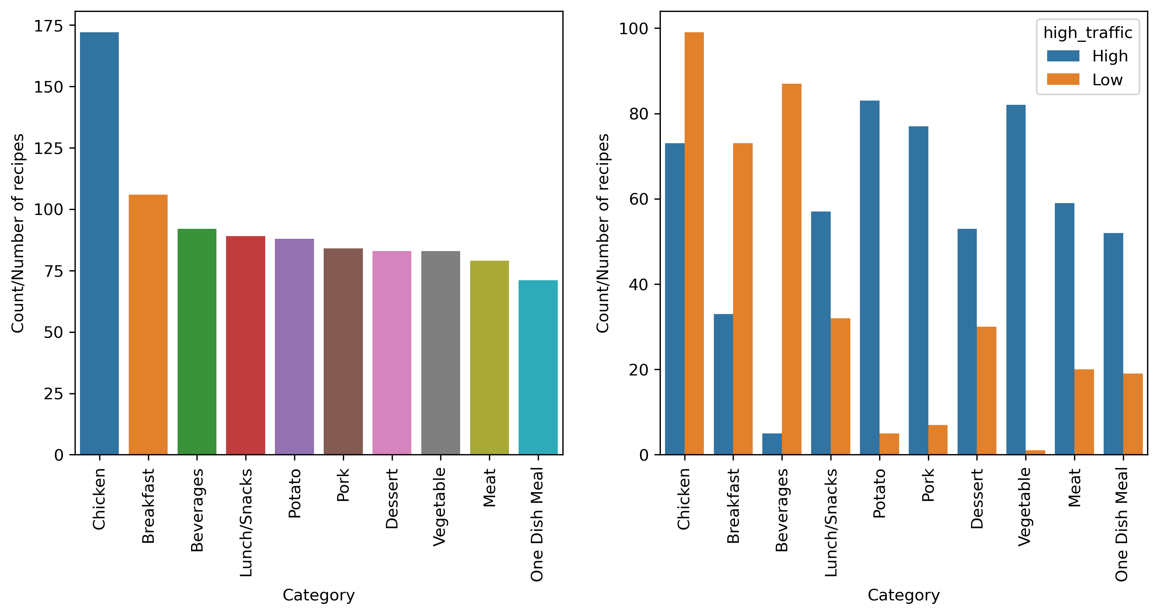
Understanding the data provided
First, I plotted the number of recipes per category.

Slide 3
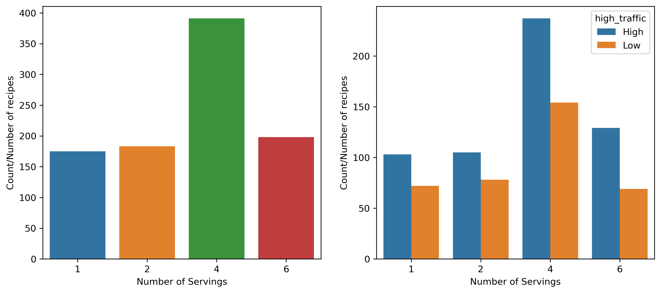
Understanding the data provided
Next, I plotted the number of recipes per serving size.

Slide 4
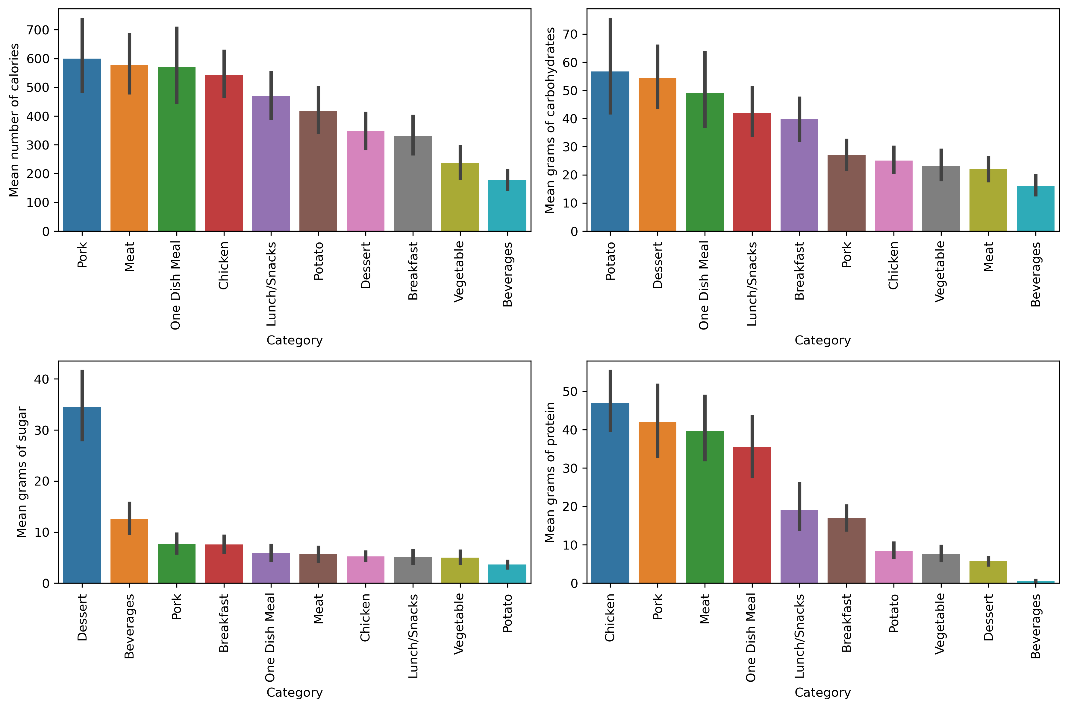
Understanding the data provided
Next, I plotted the mean number of calories, grams of carbohydrates, sugar and protein per category.

Slide 5
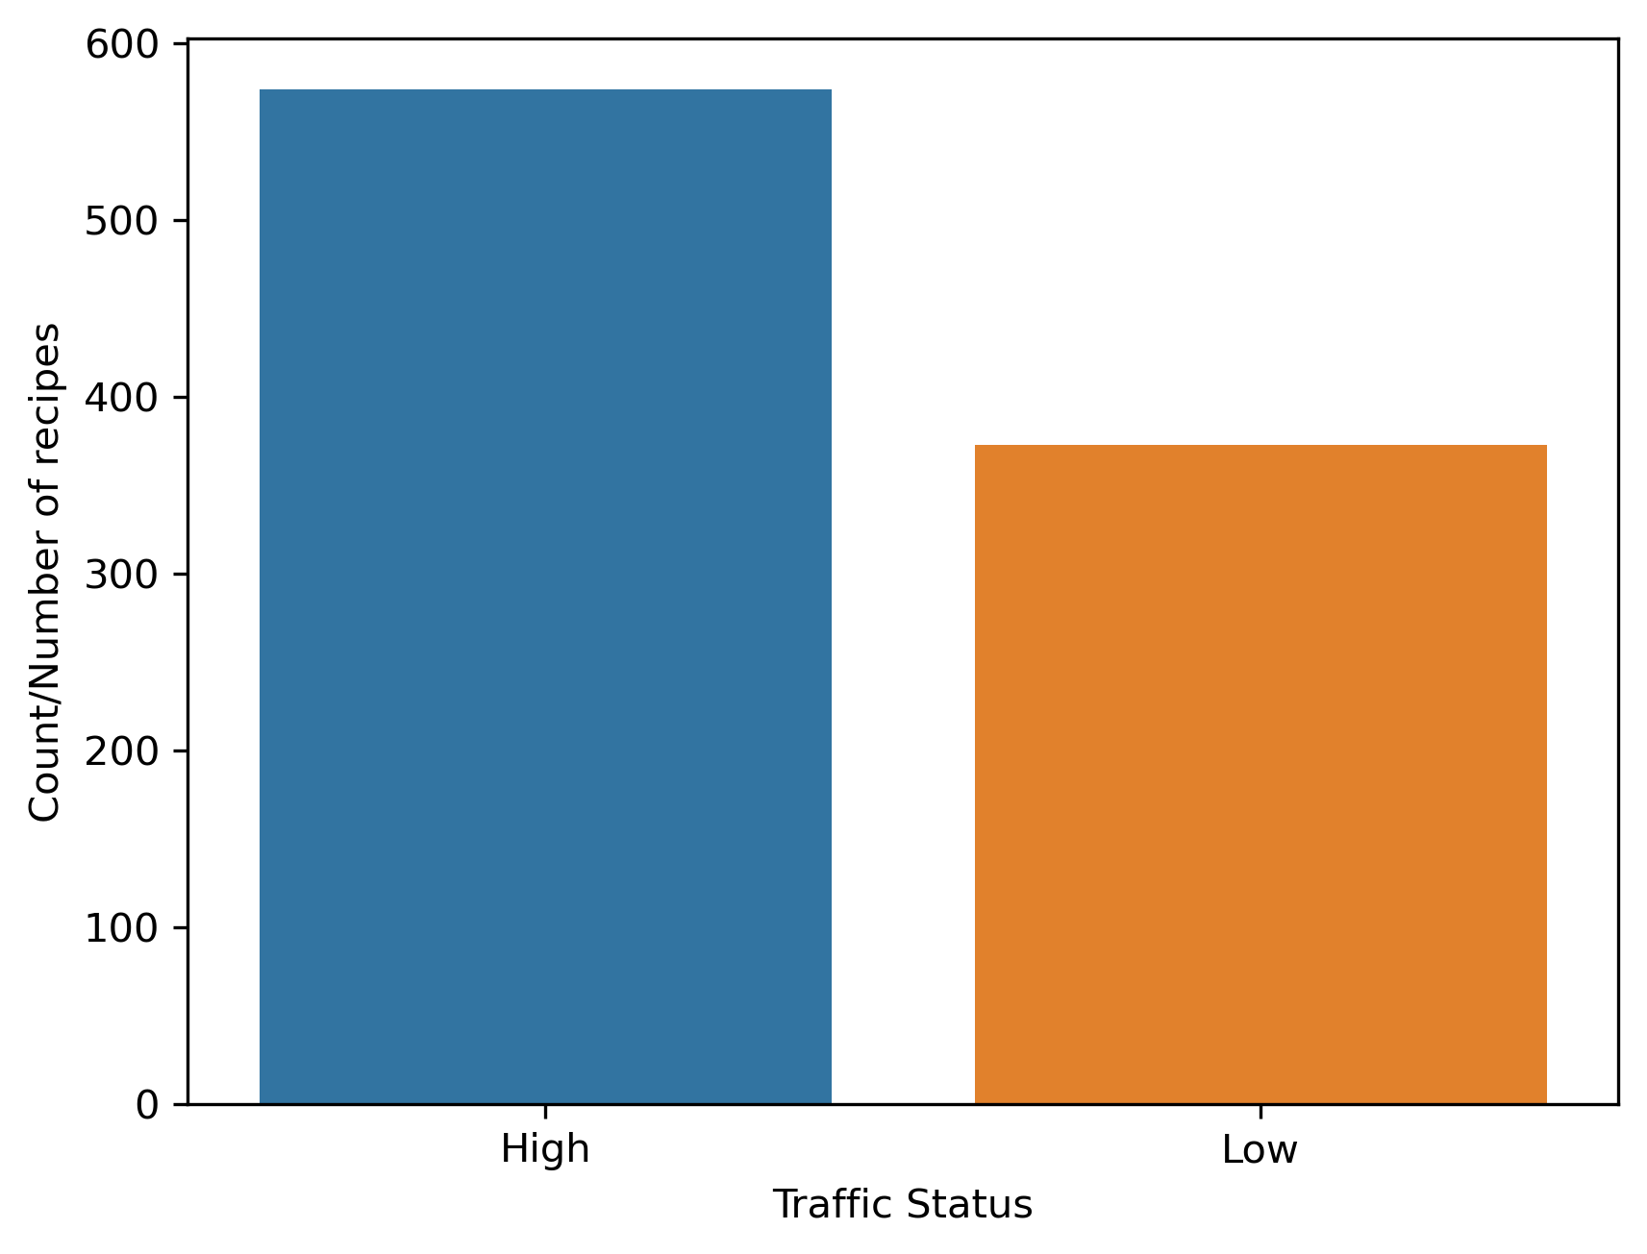
Understanding the data provided
Finally, I plotted the number of high and low traffic recipes.

Slide 6
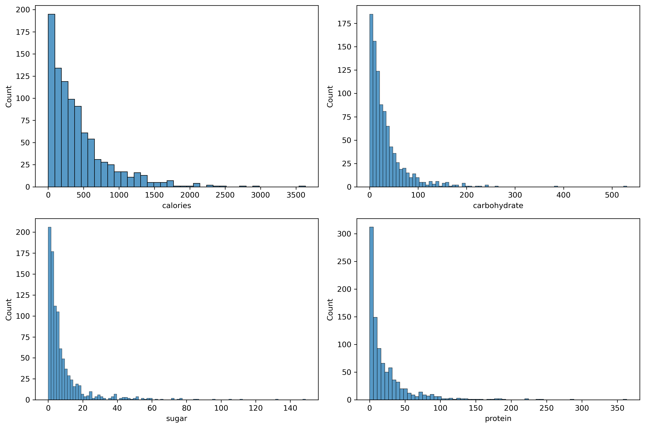
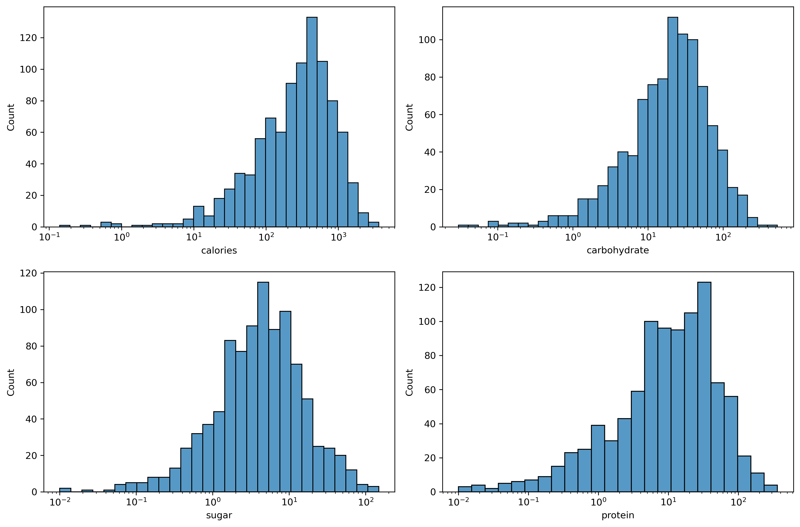
Understanding the data provided
Some of the data is skewed which we will need to scale before testing a model.

Slide 7
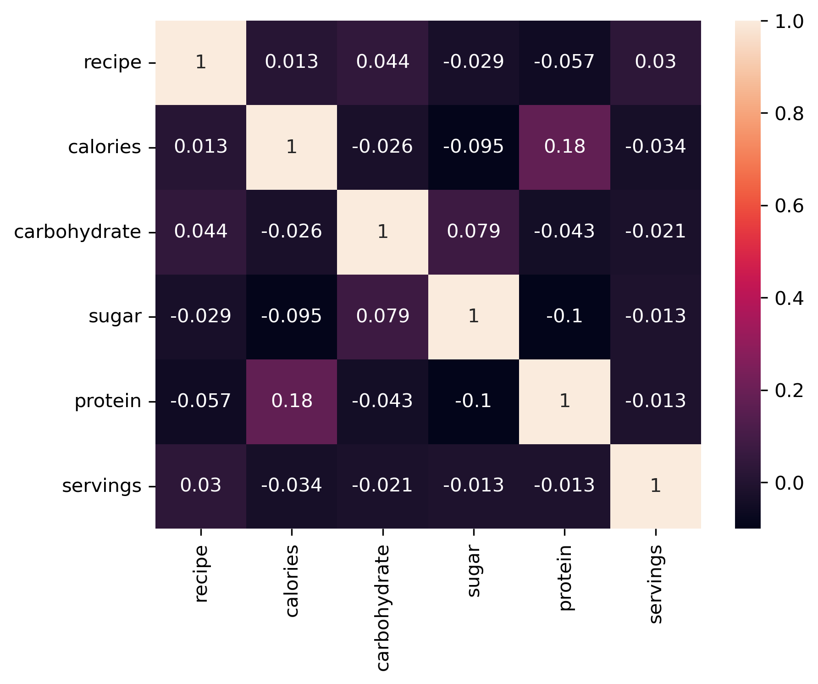
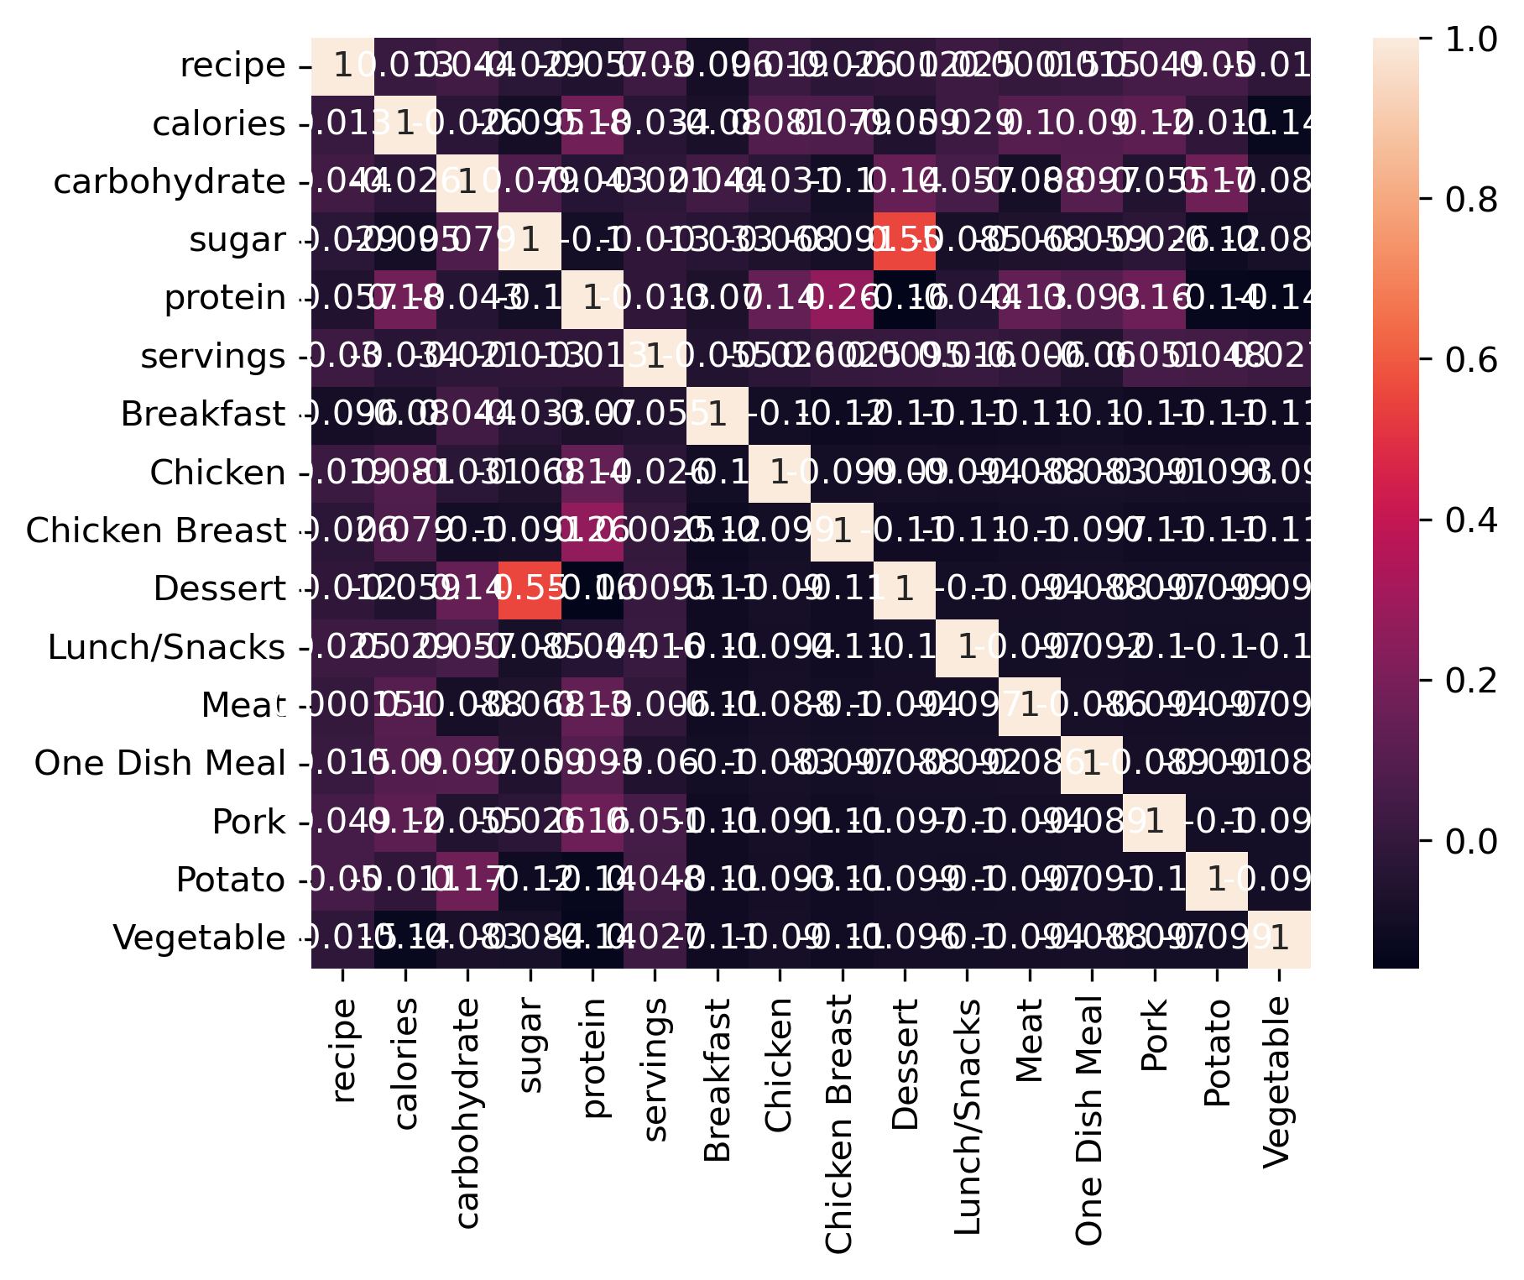
Understanding the data provided
No linear correlations were found.

Slide 8
Choosing a model & evaluation
This problem is a binary classification problem in machine learning. Together with the data characteristics I will try:
KNN model
Random Forest Classifier
For evaluating the model I choose accuracy (overall performance of the model) and recall (the proportion of actual positive cases that are correctly identified).
Prepare data for modelling:
To enable modelling, I first transformed the categorical variable 'category' into numeric features using one hot encoding. I then separated out the target variable (high traffic) from the rest of the dataset. I split the data into a training and test set and scaled the data.

Slide 9
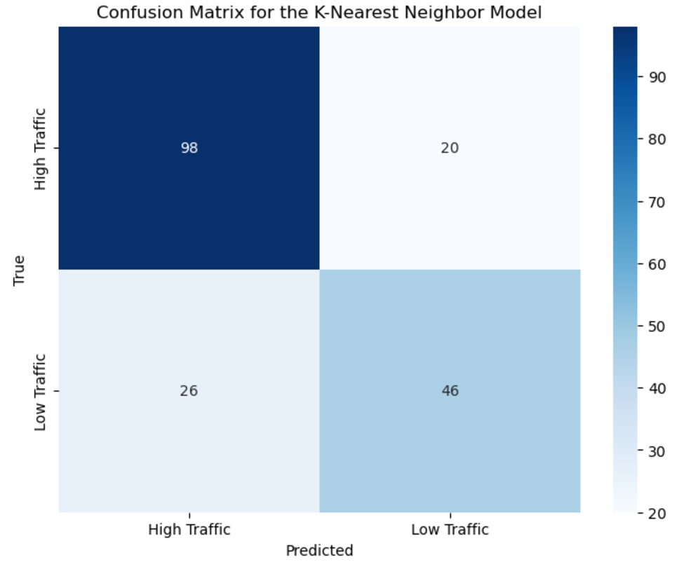
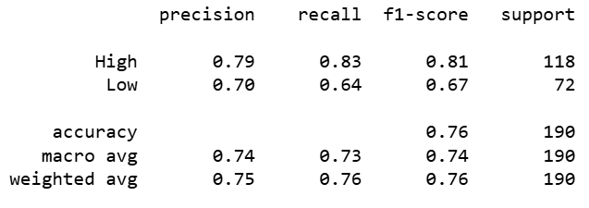
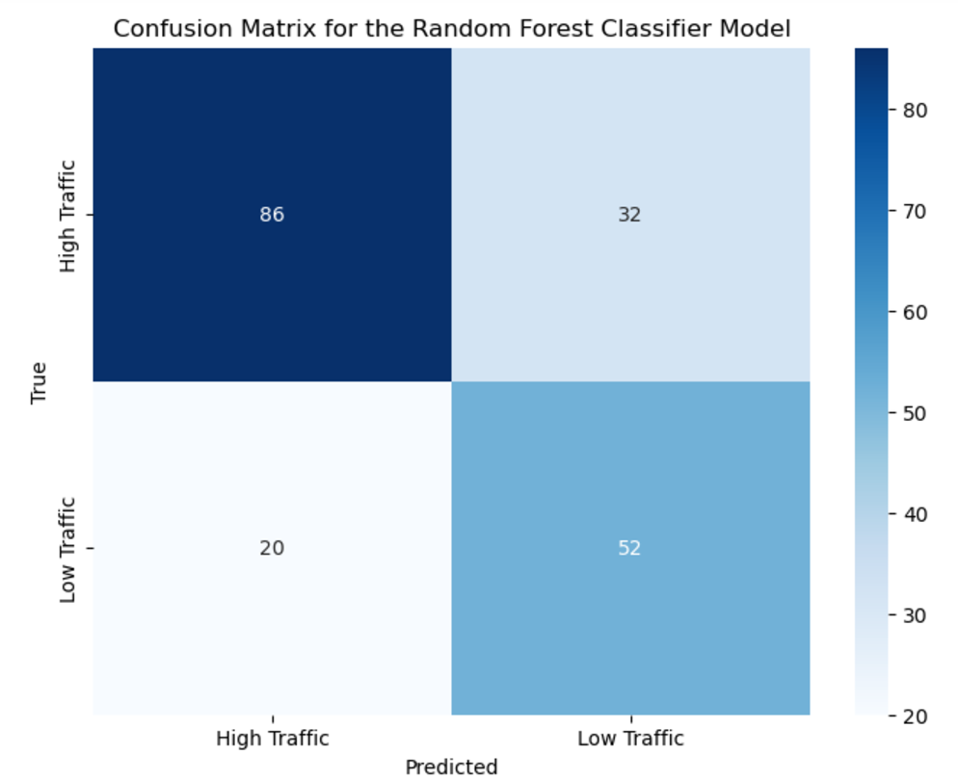
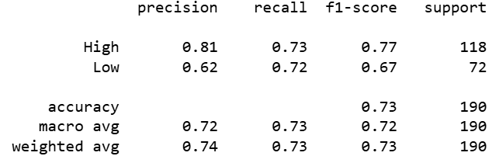
Choosing a model & evaluation
KNN
Random Forest

Slide 10
Results
The key difference between the two models lies in their accuracy in predicting low-traffic recipes. While the k-nearest neighbor model excels at identifying high-traffic recipes, it's more prone to misclassifying low-traffic recipes as high-traffic. The random forest classifier, on the other hand, is more reliable in this regard. As a result, the random forest model has a 2% higher chance of displaying truly high-traffic recipes.
1. Can your team predict which recipes will lead to high traffic?
Yes, with an accuracy of 73%, meaning that 27% of the time the model will choose incorrectly.
2. Correctly predict high traffic recipes 80% of the time?
No, we were only able to correctly predict high traffic recipes 73% of the time but the model predicted most low traffic recipes correctly as well meaning that not many low traffic recipes were predicted as high.

Slide 11

Recommendations to the business
I recommend deploying the random forest classifier model into production.
I recommend the following steps to ensure the model works well and is improved regularly:
Improve data quality and incorporate more features.
Conduct A/B testing.
Gather more data while testing the model.
Measure other metrics.

